Slide 1
Distributed Snapshots
Lecturer: Ngo Huy Bien
Software Engineering Department
Faculty of Information Technology
VNUHCM - University of Science
Ho Chi Minh City, Vietnam
nhbien@fit.hcmus.edu.vn

Slide 2

Objectives

Slide 3

Contents

Slide 4

References
K. Mani Chandy and Leslie Lamport (1985). Distributed Snapshots.

Slide 5
What are Distributed Snapshots? [1]
Processes in a distributed system communicate by sending and receiving messages. A process can record its own state and the messages it sends and receives; it can record nothing else.
To determine a global system state, a process p must enlist the cooperation of other processes that must record their own local states and send the recorded local states to p.
All processes cannot record their local states at precisely the same instant unless they have access to a common clock. We assume that processes do not share clocks or memory.

Slide 6
Stable Properties
Let y be a predicate function defined on the global states of a distributed system D; that is, y(S) is true or false for a global state S of D.
The predicate y is said to be a stable property of D if y(S) implies y(S’) for all global states S’ of D reachable from global state S of D.
In other words, if y is a stable property and y is true at a point in a computation of D, then y is true at all later points in that computation.
Examples of stable properties are “computation has terminated,” and “the system is deadlocked.”

Slide 7
Why Distributed Snapshots? (I)
Deadlock detection and termination detection are special cases of the stable-property detection problem.
The basic idea of the algorithm is that a global state S of the system is determined and y(S) is computed to see if the stable property y holds.

Slide 8
Why Distributed Snapshots? (II)
Modern systems (e.g. distributed databases) must tolerate crashes and partial failures.
A distributed snapshot enables:
Coordinated checkpointing
Rollback recovery
Exactly-once state restoration
Without consistent snapshots, recovery can violate causality or reintroduce inconsistent state.

Slide 9
Why Distributed Snapshots? (III)
In dataflow and stream-processing engines, snapshots enable:
Fault-tolerant stateful operators
Exactly-once processing guarantees
Deterministic replay
Modern stream systems periodically take distributed snapshots of operator state and message channels to enable recovery without duplication.

Slide 10
Why Distributed Snapshots? (IV)
In a sharded system, the state is partitioned across nodes.
A consistent global view therefore requires collecting the state of all shards simultaneously.
Distributed snapshots provide a mechanism to capture a consistent global state across shards without halting the system, which is useful for recovery, monitoring, and correctness verification.

Slide 11


Slide 12
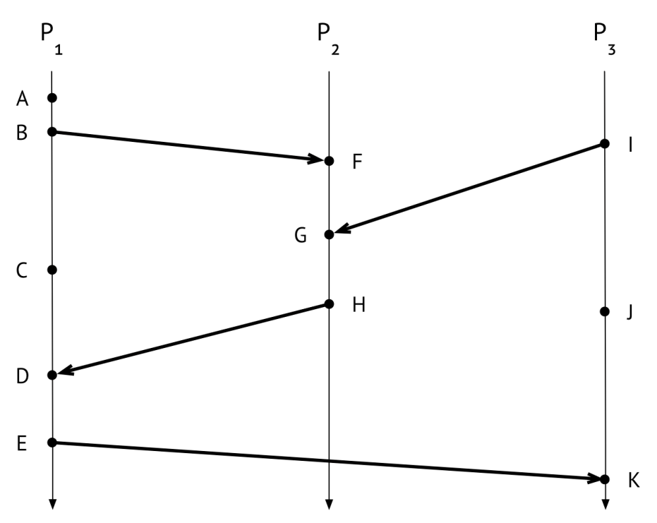
The Execution
https://decomposition.al/blog/2019/04/26/an-example-run-of-the-chandy-lamport-snapshot-algorithm/

Slide 13
Initiating a snapshot
To get a snapshot started, an initiating process has to do three things:
First, it has to record its own state.
Next – immediately after recording its own state, and before it does anything else – it has to send a marker message out on each of its outgoing channels.
Finally, it needs to start keeping track of the messages it receives on all of its incoming channels.

Slide 14
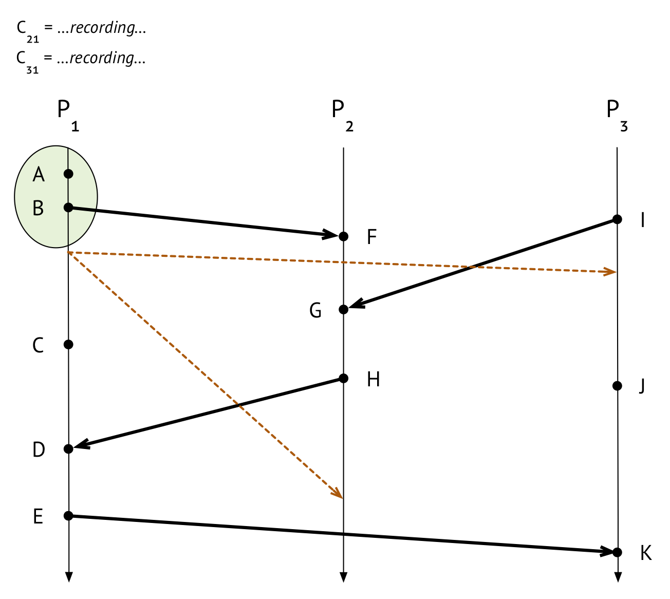
Starting distributed snapshot

Slide 15
Receiving a marker message (I)
the “this is the first marker message I’ve ever seen” case
Record its own state.
Mark the channel that the marker message came in on, as empty.
Send marker messages out itself, on all its outgoing channels.
Start recording incoming messages on all its incoming channels except the one that it just marked as empty.

Slide 16
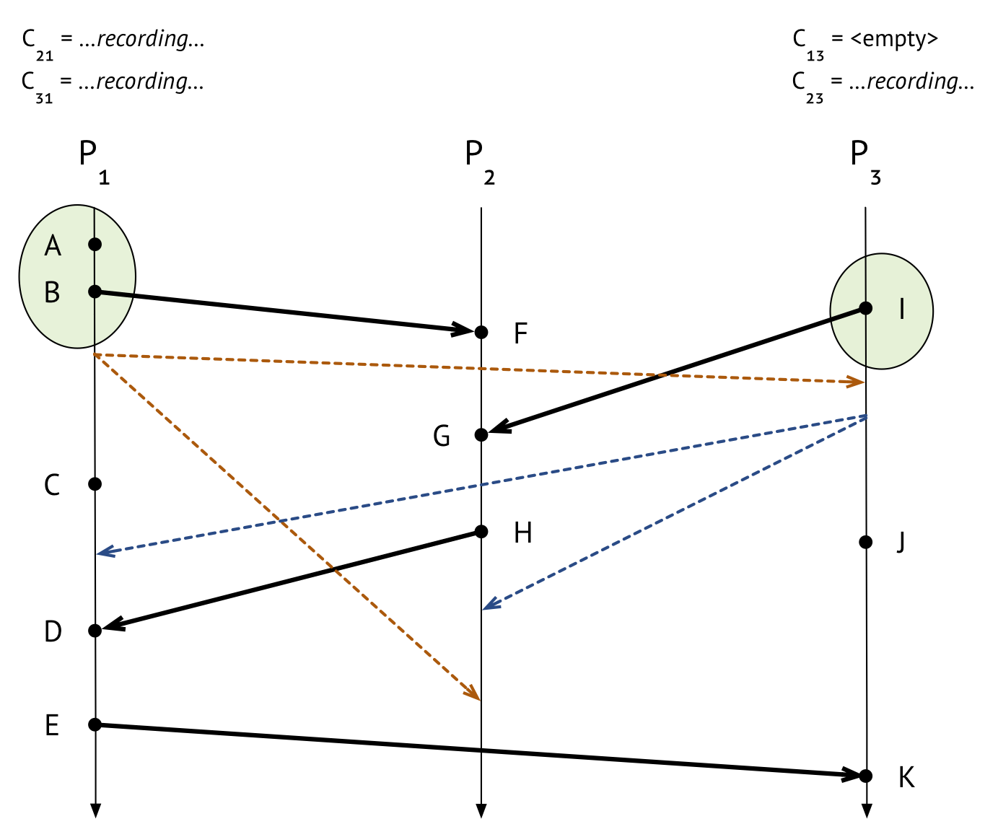
Receiving a marker message (II)

Slide 17
Receiving a marker message (III)
the “this ain’t my first rodeo” case
it should stop recording on C_ki (note that it would have started recording on C_ki back when it saw its first marker message), and it should set C_ki’s final state as the sequence of all the messages that arrived on since recording began.

Slide 18

Receiving a marker message (IV)

Slide 19
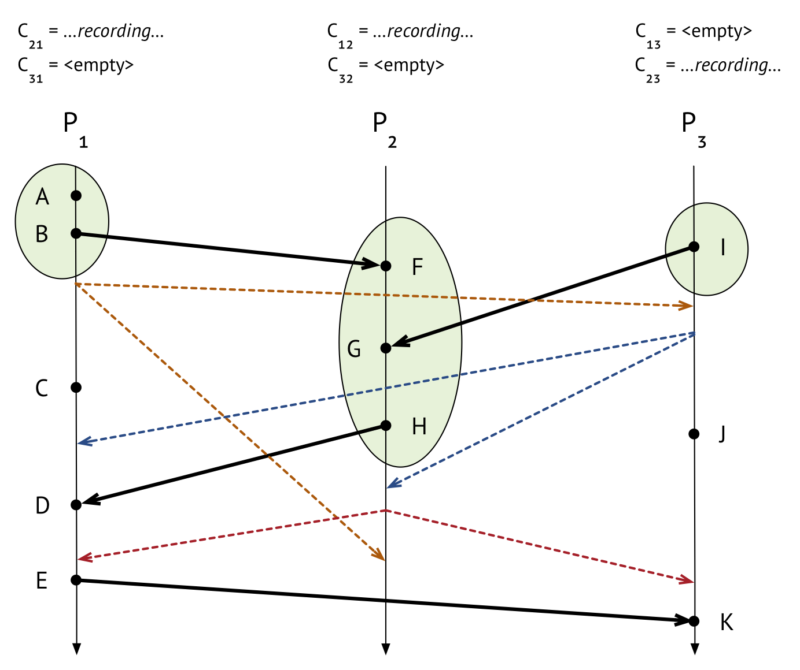
Finishing up

Slide 20
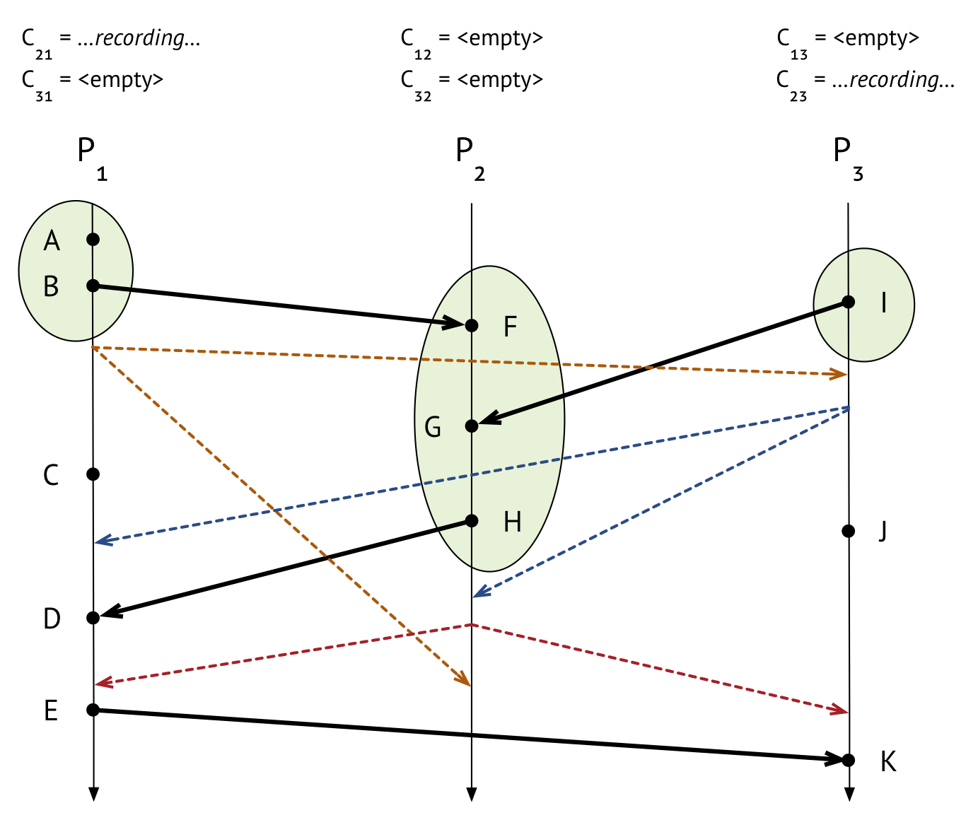
C₁₂ is done

Slide 21

C₂₁ is done

Slide 22
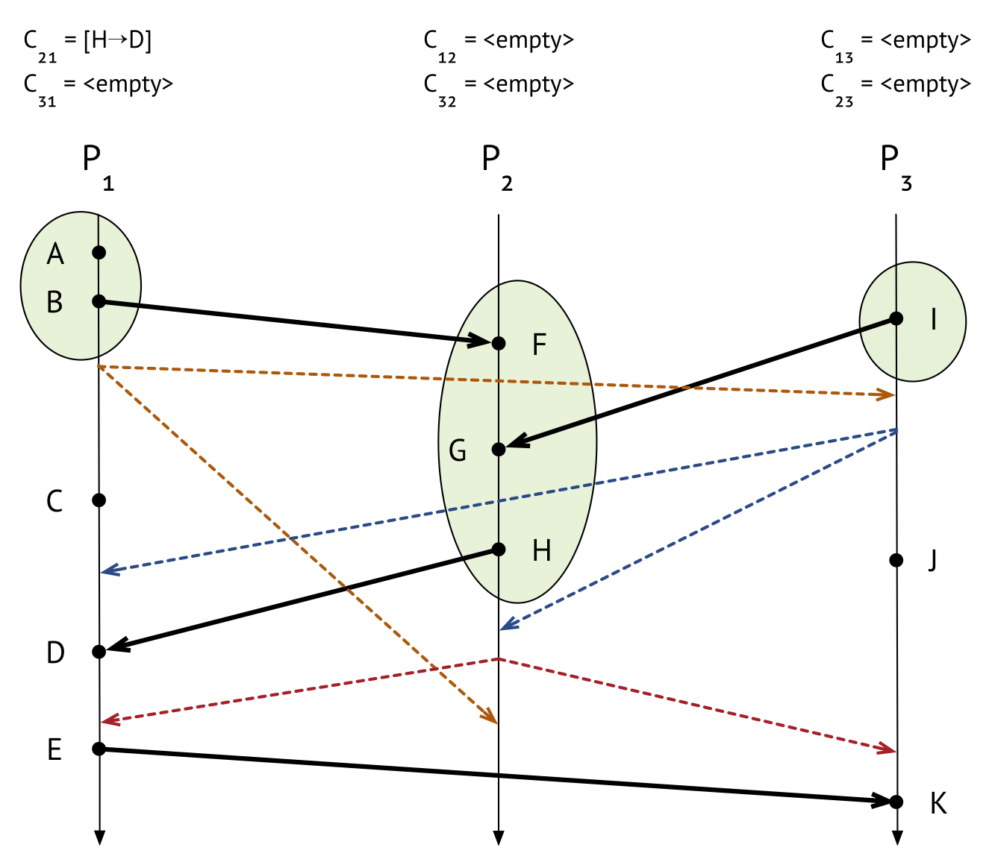
C₂₃ is done

Slide 23
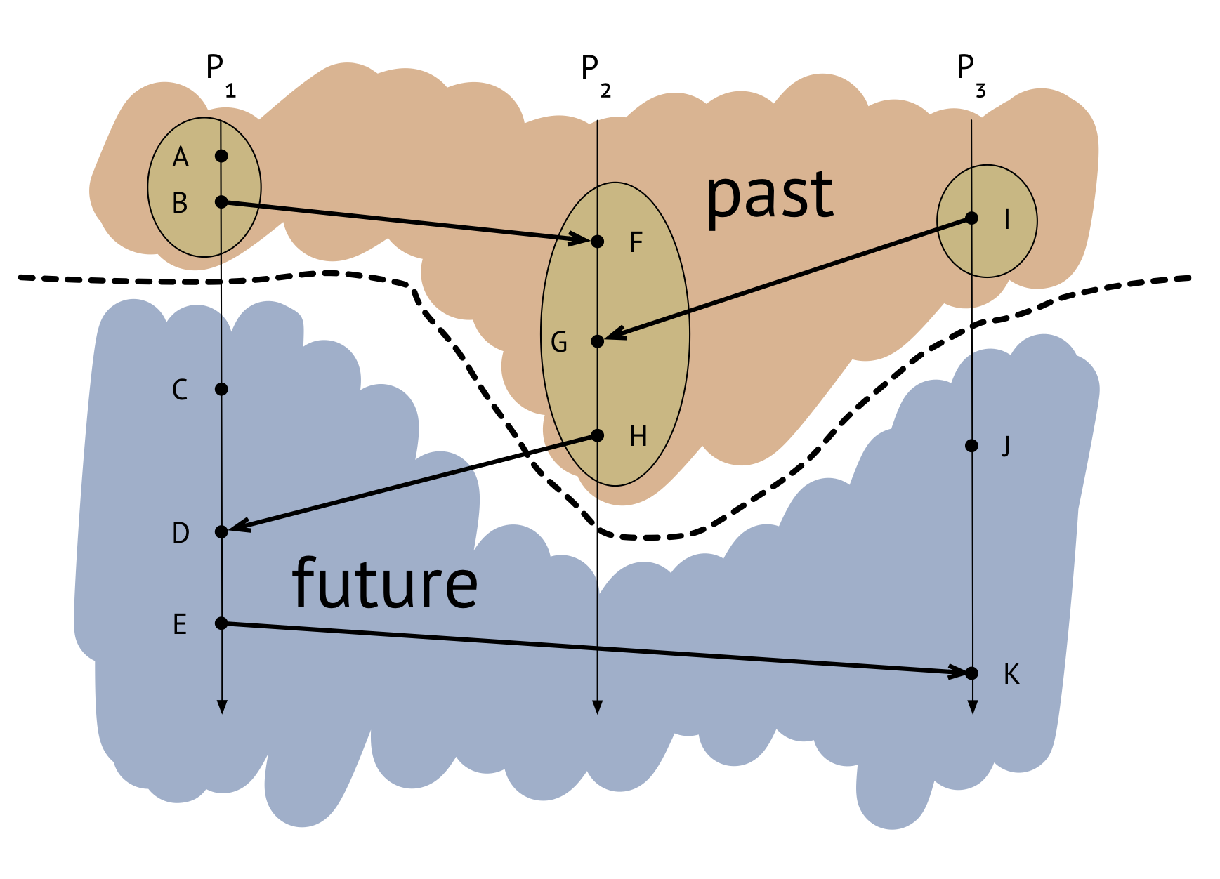
The snapshot

Slide 24

Thank You & See You Again

